Slide 2
Online Marketplace – October, 2010
255 million websites
40 new websites launched per/minute
202 million top level domain names
7% increase from 2009
1.97 billion internet users worldwide
14% increase from 2009
340 of every 100,000 adults launched a business each month, creating 565,000 startups.
Rate of new business creation steadily rising since 2006.

Slide 3
Product – The Big Idea
To offer the opportunity to anyone who has the ambition of owning a company, but lacks resources, funding, or specialized skills the ability to start and successfully operate a profitable, low maintenance online business.

Slide 4
Product - Features
Basic Package - Website
6 available in the following industries
Marketing for entertainers, dating network, personal auction service, b2b ad network, virtual mall, and a night life promotion business
Tested and optimized for target market
Control panel to allow users with no programming knowledge to operate
Setup with payment processing, hosting, and all other necessary services
Consulting Package – Documentation & Support
Extensive documentation covering all aspects of the business
Consulting & technical support
Full Marketing Package – Setup & Design
Setup of marketing channels
Design of promotional material
Start-up advertising services

Slide 5
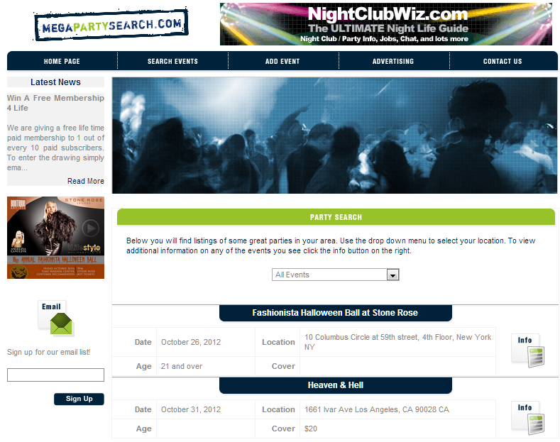
Product – How It Works
Example 1
Night Life Promotion Business
Market Night Club & Concert Events
to Young People
Venue owners & promoters pay a subscription fee to list their event info on the website.
Client’s job - Market the website to night life enthusiasts using techniques we show in order to expose them to the listed events.

Slide 6
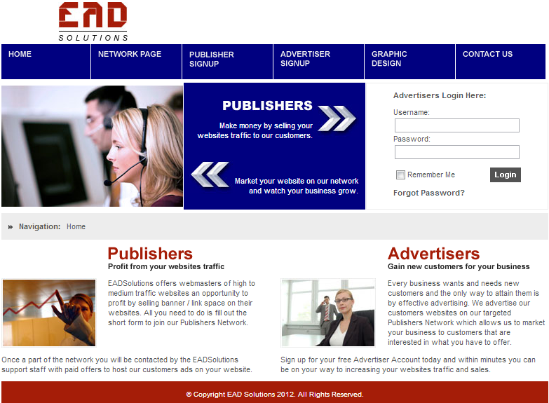
Product – How It Works
Example 2
Business 2 Business Ad Network
Connect Publishers & Advertisers in an Automated Virtual Banner Exchange Network
Publishers – Pay subscription fee to be included in the network in order to sell web traffic.
Advertisers – Pay subscription fee to have their banners hosted on content targeted websites.
Client’s job - Market the business to website owners.

Slide 7
Product - Qualifications
Must provide an automatic, subscription based service
Significantly reduces skill level required to operate
Must not be within an industry that requires licensing or specialized skills
Preliminary 3 month test launch. Website will be optimized during this time based on customer feedback
Must be in operation for a minimum of 2 years or until the website shows a minimum of100% return on investment
Proves income potential

Slide 8
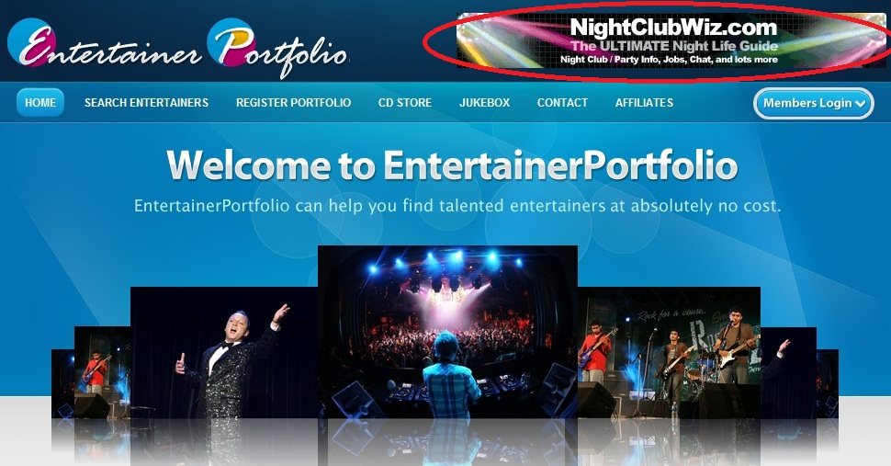
Product – Differentiation Instant Revenue Model
Banner advertising initiated day of purchase
$45 per/month average starting payout
Re-negotiated after the third month based on traffic and performance

Slide 9
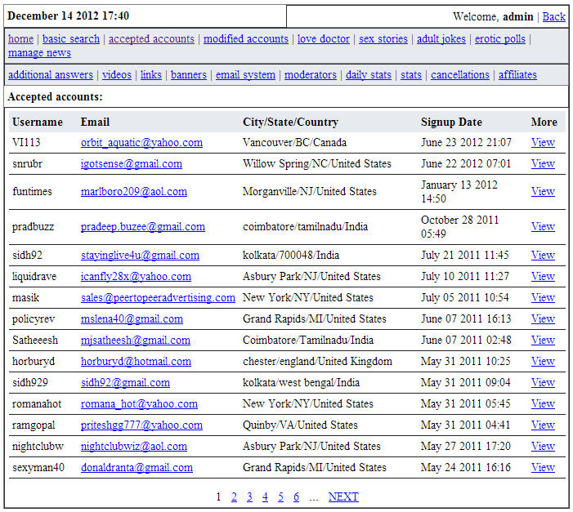
Product – Differentiation Leads Database
Highly targeted leads to will help get the business going faster
Having members on the website will make it look more active and therefore make it easier to attract new members

Slide 10
Full Website Broker | Service Business Development
Do It | Yourself

Slide 11
Competitor Overview
Primary competitors – Popular get rich quick schemes:
John Beck’s Free & Clear Real Estate System
Sell “The Greatest Vitamin in the World”
Quixtar
4X Made Easy (Wizetrade)
Free Money to Pay Your Bills
Secondary competitors – Website auctions and brokers:
Flippa.com
Websitebroker.com
Dealasite.com
Ebay.com
Distant competitors – Website template makers:
Templatemonster.com
Templatemagician.com
Page-zone.com
Hosting services like godaddy.com and 1and1.com

Slide 12
Product – Target Market
PRIMARY:
Newly unemployed individuals. These will be ideal clients for our offering for two reasons:
They are likely in a point of their life where they are rethinking their career path
They may have gained access to extra spending money via a severance package
Individuals and families looking for a side income
Recent college graduates seeking an 8-5 alternative
Individuals frustrated with their repetitive and non-challenging work environment and seeking an exciting alternative with growth potential
SECONDARY
Website developers interested in purchasing pre-made code to enhance or speed up their ongoing projects
Website template sellers looking to expand their inventory
Established entrepreneurs who would like to pursue a new venture

Slide 13
Product – Revenue Model
Initial sale revenue:
$1,600 average – Basic Package
$2,900 average – Consulting Package
$5,500 average – Full Marketing Package
Website hosting and updates revenue:
$7 per/month average
Website updates – $300 year 1, $150 year 2, $100 year 3
3 year average retention.
Post sale advertising services revenue:
Average $1,500 lifetime
Expenses:
$120 design & content fee
83c per/month domain hosting (1 year average)
$30 average loss from instant revenue promotion
25% of affiliate referred sales
2.5% credit card processing
Estimated revenue per/sale - $5,848
$4,000(average initial sale price) + $252(3 years of hosting) + $1,500 (average post sale advertising revenue) + $300 + $550 (website updates
= $6,302 Profit
$120 (average design & content cost) + $10 (average domain hosting pre sale) + $30 (instant revenue promo) + $150 (affiliate payout) + $144 (credit card processing)
= $454 Expenditures

Slide 14
Management Team
Andrew Witzigman - CEO
Founder of StartUpEssential
Masters in marketing analytics from NYU
Chris Yates - CMO
CEO of Vision Group
Owner of BuyingAndSellingWebsites.com
Bachelor degree in computer science from University of Montana
Adam Berenstein – CFO
MBA in finance from Rutgers University
Financial Analyst at Bank of Montreal
Asif Khan – CCO
CEO of TheCreativeWritingWorld.com

Slide 15
Strategic Partners
Cross Promotion
StartUpNation.com
TheFastLaneForum.com
Design
Indian IQ
Web Pro India
Blue Chip Technosys
Content writer
Tony Henriquez
Writer for clubplanet.com

Slide 16
Advisory Board
John W Dobrovski – Legal
Law degree from Richmond School of Law
Attorney specializing in internet law
Meenu Thukral - Programming & Design
Lead developer at Emphatic Technologies
Very up-to date on all changes in website development industry
Jose Gonzales – Unemployment Trends
Owner of The405Club.com

Slide 17
Marketing - Overview
Marketing strategy will be split between targeting each business being sold individually and the main offering as a whole.
Media Channel | Year 1 Spend
StartUpEssential.com | $1,100
Affiliate Program | $4,000
Social | $28,000
Search | $34,000
Banner | $24,000
Print | $30,000
Email | $10,500
Conference | $10,000
Other | $10,226

Slide 18
StartUpEssential.com

Slide 19
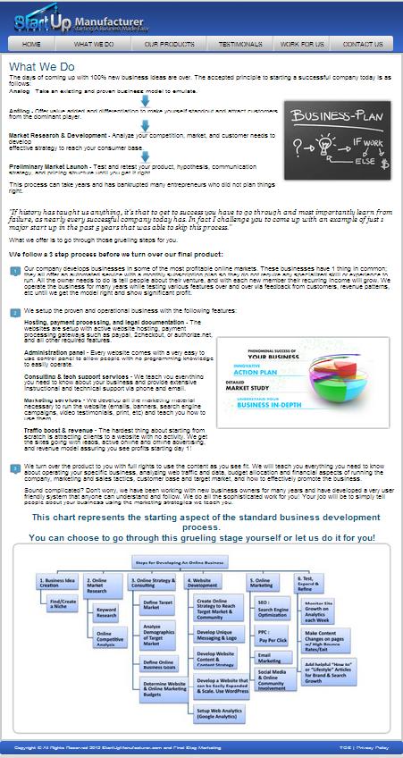
What We Do?

Slide 20
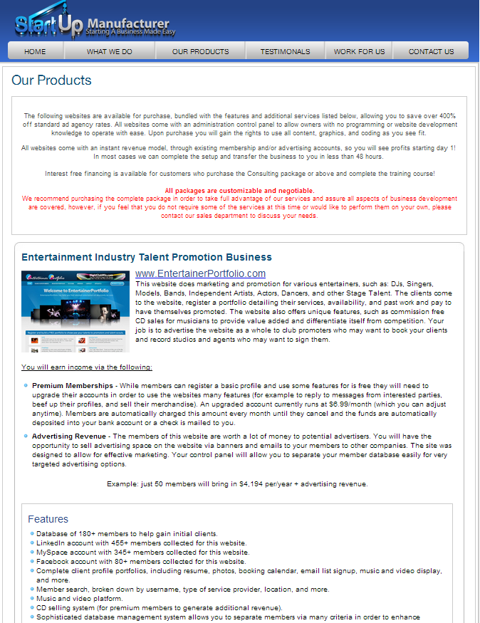
Our Products

Slide 21
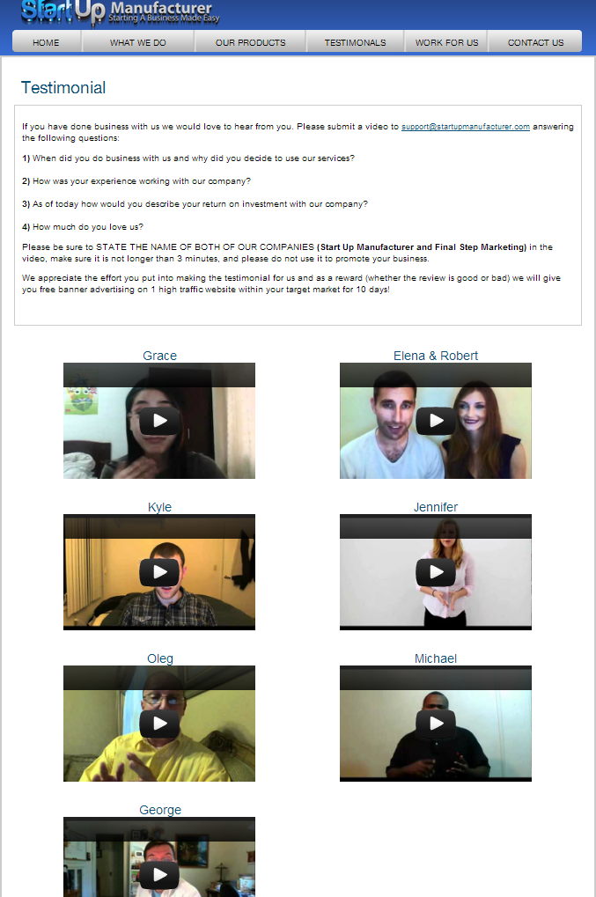
Testimonials

Slide 22
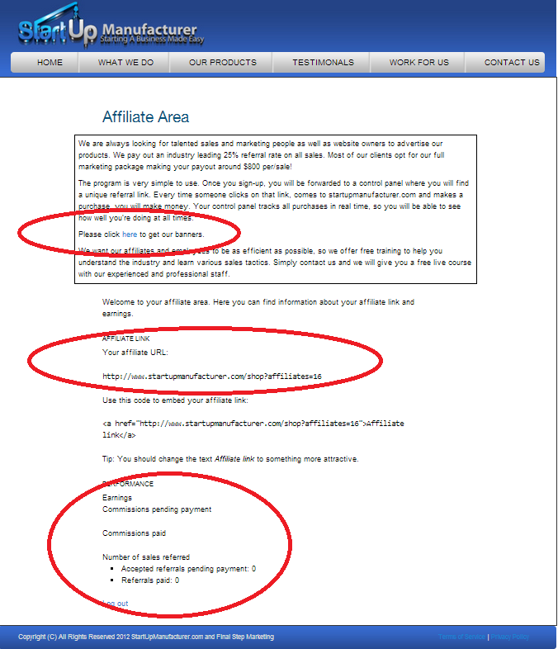
Affiliate Program

Slide 23
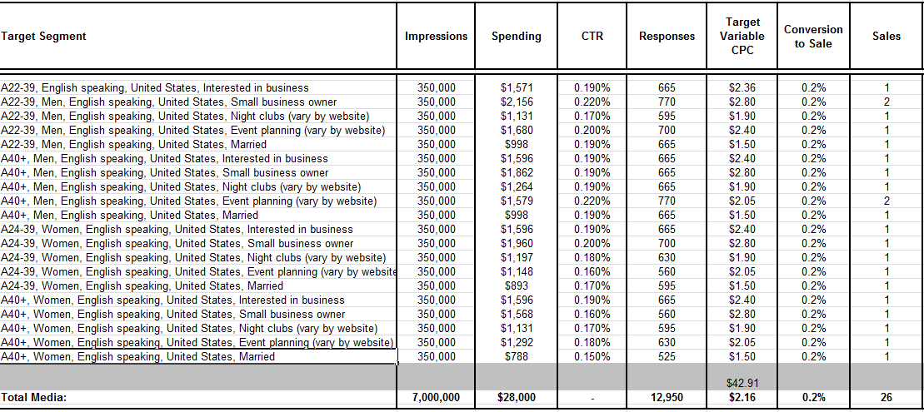
Marketing - Social Media

Slide 24
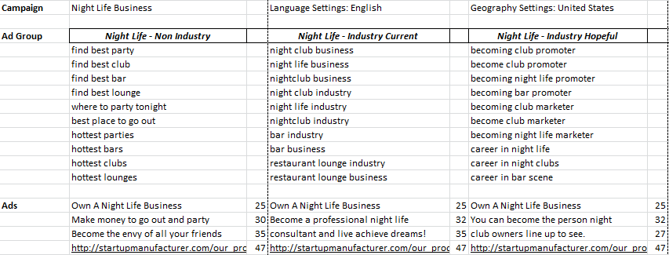
Marketing – Search Engine

Slide 25
Marketing – Banner Display
Startupnation.com – Popular information source on how to build a business.
Theworkbuzz.com – A community for job seekers.
Experienceproject.com – A community for people dealing with various issues, many revolving around financial and professional struggles.
Moneyfanclub.com – Community focused on discovering unconventional ways to make money online.
Babycrowd.com – Large community section dedicated to stay at home moms.

Slide 26
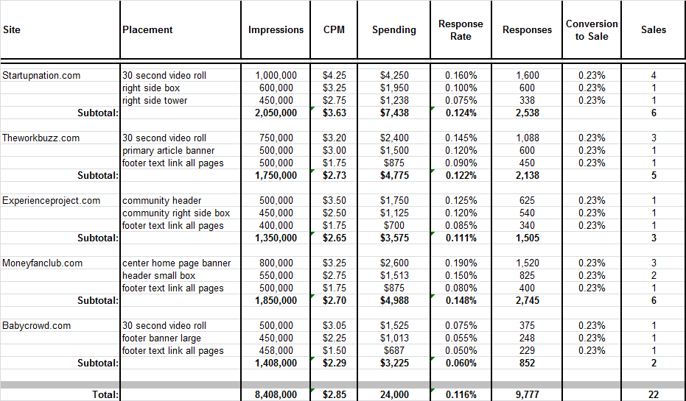
Marketing - Banner Display

Slide 27
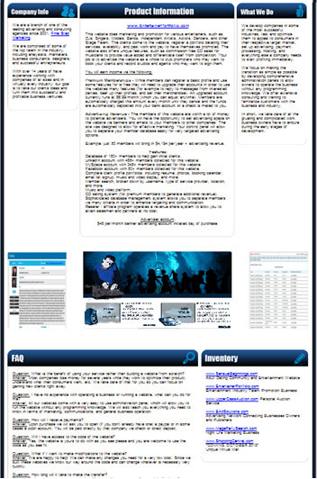
Marketing - Email

Slide 28
Marketing - Print
MBA Biz Magazine
Increase credibility in the business community
Reach business students
Home Business Advertiser Magazine
Reach families and individuals interested in running
a home based business

Slide 29
Final Media Mix

Slide 30
“How To Start & Successfully Operate a Business Even If You Know NOTHING About Business!”

Slide 31
Other Marketing Expenses
$10,000 to host the “How To Start & Successfully Operate a Business Even If You Know NOTHING About Business!” conference
Sponsored by local business
Further compensated by guest speakers
$4,000 – Affiliate program promotion
15% of sales are expected to be affiliate generated
$4,000 - SEO
$1,918 - business cards, t-shirts (300), and other promotional material
$4,000 - miscellaneous expenses

Slide 32
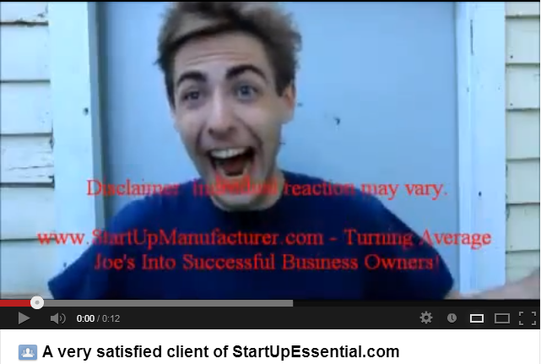
Marketing Materials

Slide 33
Price Structure Testing & Data Analysis
Oprimizely
Test multiple price models to determine optimal structure and further segment the target market.
Data collection during checkout process
Pitch customers who abandon checkout process
Improve sales conversion
Optimize checkout process with Amazon type model

Slide 34
Operations - Timetable
Date | Execution | Cost
December, 2012 | Design and development of StartUpEssential.com website | $1,100 initial development cost
December, 2013 | Testing and data analysis via Optimizely Gold Package to develop optimal price structure | $4,308 per / year
December, 2013 | Midtown NYC office space | $54,000 per / year
December, 2015 | Expand inventory by launching 4 new websites | $10,000 over 2 year period (starting year 2)

Slide 35
Operations - Milestones
Date | Goal
December 2013 | Reach $500,000 in total revenue
December 2014 | Reach $1,250,000 in total revenue
December 2015 | Reach $1,750,000 in total revenue

Slide 36
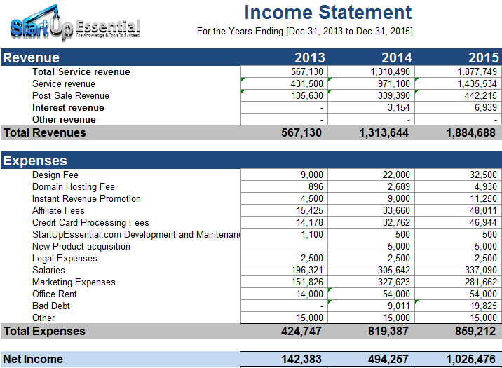

Slide 38
Expenditures
[A] | Design Fee
 | Year | Customers | Exp | Total
 | 1 | 100 | 90 | 9,000
 | 2 | 200 | 110 | 22,000
 | 3 | 250 | 130 | 32,500
[B] | Domain Hosting Fee
 | Year | Customers | Exp | Total
 | 1 | 90 | 9.96 | 896
 | 2 | 270 | 9.96 | 2,689
 | 3 | 495 | 9.96 | 4,930
[C] | Instant Revenue Promotion
 | Year | Customers | Exp | Total
 | 1 | 100 | 45 | 4500
 | 2 | 200 | 45 | 9000
 | 3 | 250 | 45 | 11250

Slide 39
[D] | Affiliate Fees
 | Sr. No. | Packages | Range | Average Expenditure per Customer |  |  | Customers |  |  | % of Total Customers
 |  |  |  | Year 1 | Year 2 | Year 3 | Year 1 | Year 2 | Year 3
 | 1 | Basic | $1,000 - 2,200 | 400 | 440 | 506 | 2 | 5 | 6 | 15.00%
 | 2 | Consulting | $2,200 - 3,600 | 725 | 798 | 917 | 5 | 11 | 13 | 35.00%
 | 3 | Full Marketing | $5,000 - 6,000 | 1375 | 1513 | 1740 | 8 | 15 | 19 | 50.00%
 |  |  |  |  |  |  | 15 | 30 | 38 | 100.00%
 | Note 1 | Assumed that 15% of sales are affiliate based
 | Note 2 | Assumed that 25% of paid as Affiliate Fees
[E] | Credit Card Processing Fees
 | Year | Expenditure
 | 1 | 14,178
 | 2 | 32,762
 | 3 | 46,944
[F] | StartUpEssential.com Development and Maintenance
 | Year | Expenditure
 | 1 | 1100
 | 2 | 500
 | 3 | 500

Slide 40
[G] | New Product acquisition
 | Year | Expenditure
 | 1 | 0
 | 2 | 5000
 | 3 | 5000
[H] | Legal Expenses
 | Year | Expenditure
 | 1 | 2500
 | 2 | 2500
 | 3 | 2500
[I] | Salaries
 | Year | Salary |  |  |  |  |  |  | Total
 |  | CEO | CMO | CFO | Content writer | Travelling public speaker | Web-developer 1 | Web-developer 2
 | 1 | 0 | 65000 | 80000 | 3000 | 5000 | 8320 | 0 | 161321
 | 2 | 80000 | 71500 | 88000 | 4000 | 7500 | 8320 | 8320 | 267642
 | 3 | 88000 | 78650 | 96800 | 5000 | 12000 | 8320 | 8320 | 297090
[J] | Marketing Expenses
 | Year | % | Expenditure
 | 1 | 35% | 198,496
 | 2 | 25% | 327,623
 | 3 | 15% | 281,662

Slide 41
[D] | Website Advertising Revenue
 | Year | Revenue
 | 1 | 1000
 | 2 | 3000
 | 3 | 12000
[E] | Website Update Fees
 | Year | Notes | Customers | Revenue | Total
 | 1 | New | 100 | 300 | 30,000
 | 2 | New | 200 | 360 | 87,000
 |  | Last year's | 100 | 150
 | 3 | New | 250 | 432 | 154,000
 |  | Last year's | 200 | 180
 |  | Last to Last Year's | 100 | 100

Slide 42
[G] | New Product acquisition
 | Year | Expenditure
 | 1 | 0
 | 2 | 5000
 | 3 | 5000
[H] | Legal Expenses
 | Year | Expenditure
 | 1 | 2500
 | 2 | 2500
 | 3 | 2500
[I] | Salaries
 | Year | Salary |  |  |  |  |  |  | Total
 |  | CEO | CMO | CFO | Content writer | Travelling public speaker | Web-developer 1 | Web-developer 2
 | 1 | 0 | 65000 | 80000 | 3000 | 5000 | 8320 | 0 | 161321
 | 2 | 80000 | 71500 | 88000 | 4000 | 7500 | 8320 | 8320 | 267642
 | 3 | 88000 | 78650 | 96800 | 5000 | 12000 | 8320 | 8320 | 297090
[J] | Marketing Expenses
 | Year | % | Expenditure
 | 1 | 35% | 198,496
 | 2 | 25% | 327,623
 | 3 | 15% | 281,662

Slide 43
Revenues
[A] | Initial Sales Revenue
 | Sr. No. | Packages | Range | Average Initial Sales Revenue per Customer |  |  | Customers |  |  | % of Total Customers
 |  |  |  | Year 1 | Year 2 | Year 3 | Year 1 | Year 2 | Year 3
 | 1 | Basic | $1,000 - 2,200 | 1600 | 1760 | 2024 | 15 | 30 | 38 | 15.00%
 | 2 | Consulting | $2,200 - 3,600 | 2900 | 3190 | 3669 | 35 | 70 | 88 | 35.00%
 | 3 | Full Marketing | $5,000 - 6,000 | 5500 | 6050 | 6958 | 50 | 100 | 125 | 50.00%
 |  |  |  |  |  |  | 100 | 200 | 250 | 100.00%
 | Note 1 | Assumed Growth for Average Revenue per customer |  |  |  | Year 2 | 10%
 |  |  |  |  |  | Year 3 | 15%
[B] | Website hosting
 | Sr. No. | Service | Range | Average Revenue per Customer | Customers
 |  |  |  |  | Year 1 | Year 2 | Year 3
 | 1 | New customers | $ 5 - 9 | 7 | 90 | 180 | 225
 | 2 | Continued from last year | $ 5 - 9 | 7 | 0 | 90 | 180
 | 3 | Continued from last to last year | $ 5 - 9 | 7 | 0 | 0 | 90
 |  |  |  |  | 90 | 270 | 495
 | Note 3 | Assumed that Customer is retained for 3 years average
[C] | Post sale advertising revenue
 | Year | Customers | Revenue | Total
 | 1 | 90 | 1500 | 135,000
 | 2 | 180 | 1875 | 337,500
 | 3 | 225 | 1950 | 438,750

Slide 44
Break Even Analysis
Year |  | 2013 | 2014 | 2015
Net Projected Sales |  | 567,130 | 1,310,490 | 1,877,749
Net Projected Cost of Sales |  | 261,095 | 459,745 | 468,122
Net Projected Fixed Costs |  | 175,321 | 321,642 | 351,090
Break Even Sales |  | 436,416 | 781,387 | 819,212

Slide 45
Summary
 |  |  | Year 1 | Year 2 | Year 3
Revenue
[A] | Initial Sales Revenue
 | Basic |  | 24,000 | 52,800 | 76,912
 | Consulting |  | 101,500 | 223,300 | 322,872
 | Full Marketing |  | 275,000 | 605,000 | 869,750
[B] | Website hosting |  | 630 | 1,890 | 3,465
[C] | Post sale advertising revenue |  | 135,000 | 337,500 | 438,750
[D] | Website Advertising Revenue |  | 1,000 | 3,000 | 12,000
[E] | Website Update Fees |  | 30,000 | 87,000 | 154,000
 |  |  | 567,130 | 1,310,490 | 1,877,749
Expenses
[A] | Design Fee |  | 9,000 | 22,000 | 32,500
[B] | Domain Hosting Fee |  | 896 | 2,689 | 4,930
[C] | Instant Revenue Promotion |  | 4,500 | 9,000 | 11,250
[D] | Affiliate Fees
 | Basic |  | 800 | 2,200 | 3,036
 | Consulting |  | 3,625 | 8,773 | 11,924
 | Full Marketing |  | 11,000 | 22,688 | 33,051
[E] | Credit Card Processing Fees |  | 14,178 | 32,762 | 46,944
[F] | StartUpEssential.com Development and Maintenance |  | 1,100 | 500 | 500
[G] | New Product acquisition |  | - | 5,000 | 5,000
[H] | Legal Expenses |  | 2,500 | 2,500 | 2,500
[I] | Salaries |  | 161,321 | 267,642 | 297,090
[J] | Marketing Expenses |  | 198,496 | 327,623 | 281,662
 |  |  | 407,416 | 703,376 | 730,387

