Slide 1
Web Strategy

Slide 2
INTRODUCTION
This Web Strategy has been prepared to be able to plan and implement the new CMS for AUS.
This includes prioritising web design, developments, allocating resource and ensuring the delivery of key web projects.
This document focuses on the steps for creating effective AUS website and navigation, also known as information architecture or IA. As of now AUS team is not involved

Slide 3
VISION
AUS Website is an important channel of communication. It is a means by which information produced by the University, be it prospectuses, handbooks, articles, or even research output, can be published.
AUS public and private website aim to be a high quality, interactive channel which supports and promotes the University’s role as a leading higher education institution with international links.
AUS web presence must continually evolve and stand up to regular benchmarking.
This Web Strategy is considered as university strategy 2015-2020 I am not aware of this strategy

Slide 4
ADDRESSING WEAKNESSES
AUS current website has many weakness and we would like highlight five key weaknesses which this strategy aims to address:
When copying/pasting content, there hidden HTML elements that don't show up on the WYSIWYG when an editor makes the changes.
Breadcrumbs is not structured to follow the URL.
Authentication issue. There is no single sign-on to both the front end and administrator panel.
Notes:
Please watch alignment. Also here we just need bullets not so much context

Slide 5
ADDRESSING WEAKNESSES
JADU CMS it has a lot of bugs according to clients reviews.
External audiences in particular found it difficult to navigate to relevant areas of the website using the options contained in the primary navigation area.
Future students as audience have the same referred point
The lack of a dedicated 'current students' section within the publicly accessible areas of the site (excluding the sub-section under ‘On Campus’) led to some confusion when trying to locate the university.
Notes:
Please be mindful of the contnet, like point 3 is not phrased right

Slide 6
ADDRESSING WEAKNESSES
The new strategy will help to implement a system whereby audiences are identified.
Knowledge of the University structure is required to quickly locate department- related information.
The current CMS is not interactive and has complicated user experience.
Notes:
Way too content heavy

Slide 7
OBJECTIVES OF THE WEB STRATEGY
Support publishing pages in high quality content
Streamlines publishing of material
Facilitates the publishing of information in an easy manner without a requirement for in-depth technical knowledge. For example, publishing information to the web will not require an understanding of HTML or experience in Drupal configuration.
Has effective content which is well presented and addresses audience needs.
Presents a coherent image of university by delivering best online services and functionality through web-based applications.
Notes:
2nd bullet missing shade?

Slide 8
OBJECTIVES OF THE WEB STRATEGY
Ease of use for site visitors
Quick and easy information retrieval.
Internal and external visitors should be able to retrieve information.
Content irrespective of its format should be searchable.
Site navigation should reflect the needs of the visitor as opposed to the formal hierarchy of the institution.
To engage in continuous improvement of the usability and effectiveness of all AUS web based services.
Driving potential students to apply
Notes:
Don’t copy paste word for word, it doesn’t make sense without accompanying context in some cases. Please try to read into it

Slide 9
OBJECTIVES OF THE WEB STRATEGY
Has appropriate technical underpinning
Can be scaled to meet the growing needs of the university.
Exhibits resilience
Data must be regularly backed up.
Avoid website downtime is minimised. For example, through duplicated systems
Improved integration and co-ordination with other applications
Notes:
Shade missing

Slide 10
OBJECTIVES OF THE WEB STRATEGY
Facilitates internal and external communication
Effectively market the services of the University to external audiences.
Empower staff and Faculty.
Promotes a sense of community and provides a strong basis for developing internal communication in AUS community website.
Provide effective web based services for all target groups
Support AUS external communities and facilitate collaboration with external collaborators.

Slide 11
DESIGN STRATEGIC APPROACH
Encompass existing content of the current site, and be broadly cross browser/platform compatible (including mobile).
Allow for easiest possible process for search engine optimization SEO.
Home page should be designed to accommodate a dynamic, flexible, quickly - changing flow of content in order to reflect the vitality and activity of campus life in real time.
Home page should feature prominent and clear calls to action that underscore the site's main goals.
The strategy approach to combine all these elements of web design together and achieve successful results, for instance (content for public website) should be improved according navigation and overall page flow.

Slide 12
DESIGN STRATEGIC APPROACH
Home page should provide greater capability for expressing “the story of American University of Sharjah” through use of marketing campaign imagery/text, photography and video content, preferably dynamic content reflecting the day - to - day vitality of the student experience
Use a site wide consistent top navigation
Specific, intuitive, easy - to - identify/access sections for prospective students, parents, alumni, current students, faculty and staff.

Slide 13
DESIGN STRATEGIC APPROACH
Build a layout that works well with each device and also redesign the images for the smaller screen, make it responsive!
Integrate social - media and community networking opportunities into the site
Design solutions that will make an abundance of information a pleasure to read , engage with and share
Adding sharing buttons to each page or articles is essential as it will allow readers to share AUS content with the click of a button and share

Slide 14
THE KEY ELEMENTS TO THE NEW WEB STRATEGY
Professional –The web presence of the university (including the website, Social media accounts for the university as a whole and the individual faculties) must be a professional representation of the university, its students, faculty and its staff.
Informational and Personalization –The key to attracting new students, more academics and more donations is making the website user better informed. Therefore attracting serious prospects can be done by adopting four essential elements.
Content: Website content is the reason visitors come to your site and engaged. If you know how users behave when faced with content on your website, you can target them with personalized communication later.
Create Personas that define and describe our primary and secondary target audience
Consider Your Target Audience’s Goals
Spend Time with Your Audience

Slide 15
THE KEY ELEMENTS TO THE NEW WEB STRATEGY
Cultural – A university is not only a place of learning. Students in AUS should feel they are part of the herd by promoting wide resources for all AUS students and focus on student needs by providing an environment in which the principles of combine’s traditional Gulf culture with a U.S.-style education.
Educational – Notwithstanding the comments in respect of extracurricular activities above, the most important feature of the university is the education students receive, AUS must show the students about the quality of what they will receive.

Slide 16
WEB STRATEGY OUTCOME – AUS.EDU
AUS Website Usability (Availability and Accessibility)
Increased enrolment
Increased awareness and familiarity of American University of Sharjah and its colleges internationally
All web touch points reflect positively on American University of Sharjah and its colleges
Web user experience & SEO is more effective and consistent for all audiences
Synergies and efficiencies increased
Differentiate from competitors

Slide 17
USER CENTRED DESIGN
Using a User-Centred Design approach to help our Web team (developers, designers) to analyse and predict how users are likely to use a and engage with website, and test these draft designs with actual users a number of times before site launch.

Slide 18
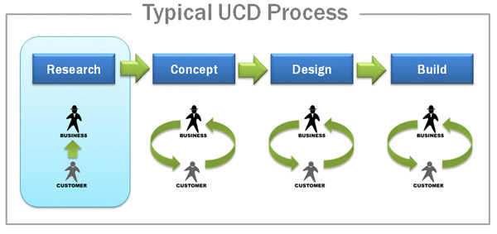
USER CENTRED DESIGN
Research: Contextual inquiry, Interviews, Survey, Workshop, Brainstorming, Content analysis
Concept: Wireframes, Design, Page layout, Navigation Modelling, Metadata design, Taxonomy
Design: Mock up, Themes, Branding, Functional Prototyping
Build: Usability testing, Website Analytics

Slide 19
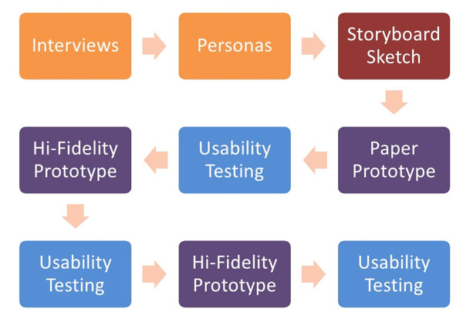
Example of UCD Process

Slide 20
CREATING INFORMATION ARCHITECTURE (IA)
Information architecture (IA) refers to the structure or organization of your website. It describes the ways in which the different pages of your site relate to one another and ensures information is organized in a consistent and predictable way on each page.
Assessing existing and needed content,
Organizing the pages,
Providing clues to help use the site efficiently, and
Developing navigational structure

Slide 21
How do we create great information architecture?
Step 1: In this first step, you need to clarify the key stakeholders’ goals
Step 2: Identify AUS Target Audience - According to AUS survey we have prepared to group AUS audience into segments (or user groups). Here are audience segments that must account for:
Students
Faculty
Staff
Parents
Potential Partners
Research partners
Alumni
Visitors
External vendors
News Media

Slide 22
How do we create great information architecture?
Step 3. Identifying your users’ goals and expectations first step, you need to clarify the key stakeholders’ goals
The ultimate goal of effective web design is to arrange AUS website so that it anticipates AUS users’ needs and expectations (we cannot stress this enough). To accomplish this, AUS project team must arrange and label information the way your target audience expects to see it.
First, collect general information about each of your interviewees.
Second, find out about the interviewee’s goals upon visiting AUS website.
Now, AUS should create data sheets for interview findings.
Once AUS has completed this activity, project team will need to create data sheets (see attached) or excel sheet for each of the interviews.

Slide 23
How do we create great information architecture?
Step 4 Build Personas
Personas bring to life your typical customers or prospects, describing their habits, preferences, objectives, and goals when using your product or service. Putting AUS in the mindset of the customer, and ask below questions.
Why should they come on AUS website,
What are they looking for,
What are users interest,
How do they interact, etc

Slide 24
How do we create great information architecture?

Slide 25
How do we create great information architecture?

Slide 26
How do we create great information architecture?
PEROSONA NAME: | Current Student/ Hala Kanan
BACKGROUND: Job, career path | Graphic design student at the College of Architecture, Art and Design Worked in the summer as a graphic design intern for 3 months
DEMOGRAPHICS: Gender, Age Range, Location | Female Age 21 Living in UAE
Goals: Persona’s primary goal Persona’s secondary goal | Finish my graduate program Working as designer in a famous fashion shop
AUS Website
Information about Colleges and Academic Departments | Neutral
Information about Academic Programs | Important
Information about the Faculty | Neutral
Financial Grants and Scholarships | Very important
Navigation | Neutral
how frequently you visit the various AUS social packages, Blog | Never
Value of the content across the website | Satisfied
CHALLENGES: Primary challenge Secondary challenge | Tuition fee for graduate program (Master Degree) Finding a job after graduation
HOW WE HELP: How we solve persona’s challenges How we help persona achieve goals | AUS offer wide range of grants, scholarships and bursaries Give graduation something interesting on by creating AUS Alumni LinkedIn group to help Alumni to find Jobs there
MARKETING MESSAGING: How should we describe our solution to persona | We are here to support you when you join the university and help you to figure out your next step to becoming a highly sought after graduation You Want to Learn and develop your career, Financial Aid Can Help.
ELEVATOR PITCH: Sell our persona on our solution | Bring a educated and helpful content in new AUS website by adding Tuition & Financial Aid link in each AUS college.
PEROSONA NAME: | Student/ Qaise Ali
BACKGROUND: Job, career path | Bachelor of Science in Mechanical Engineering Working with my brother transport company Friendship is very important to me
DEMOGRAPHICS: Gender, Age Range, Location | Male Age 22 Living in UAE
Goals: Persona’s primary goal Persona’s secondary goal | Establish my own company for Chiller - Air Conditioning Maintenance Finding a job in big company in Dubai
AUS Website
Information about Colleges and Academic Departments | Neutral
Information about Academic Programs | Important
Information about the Faculty | Neutral
Financial Grants and Scholarships | Very important
Navigation | Neutral
how frequently you visit the various AUS social Facebook | Rarely
Value of the content across the website | Neutral
CHALLENGES: Primary challenge Secondary challenge | Studying at AUS and finding resources has been a challenge Tuition fee
HOW WE HELP: How we solve persona’s challenges How we help persona achieve goals | AUS Library provides services to all AUS students in four areas: Information and Technical Services, Access Services, Preservation and Digital Imaging Services and Library Technology Services. AUS offer wide range of grants, scholarships and bursaries
MARKETING MESSAGING: How should we describe our solution to persona | We are here to support you when you join the university and help you to figure out your next step to becoming a highly sought after graduation You Want to Learn and develop your career, Financial Aid Can Help.
ELEVATOR PITCH: Sell our persona on our solution | AUS Library platform has a platform to serve AUS’s faculty, staff, students and researchers with skill and innovation Bring an educated and helpful content in new AUS website by adding Tuition & Financial Aid link in each AUS College.

Slide 27
How do we create great information architecture?
Step 4: Defining AUS site’s content areas.
First, analyse the content you already have — either in print or on the Web — and decide which pieces should be added to AUS new site, updated or discarded.
Next, list all of the content areas that AUS users will want to find it on AUS website. The ideal way to do this is to ask a wide sampling of actual users (who are members of your target audiences) what they will be seeking (review “conducting user interviews and creating data sheets”).

Slide 28
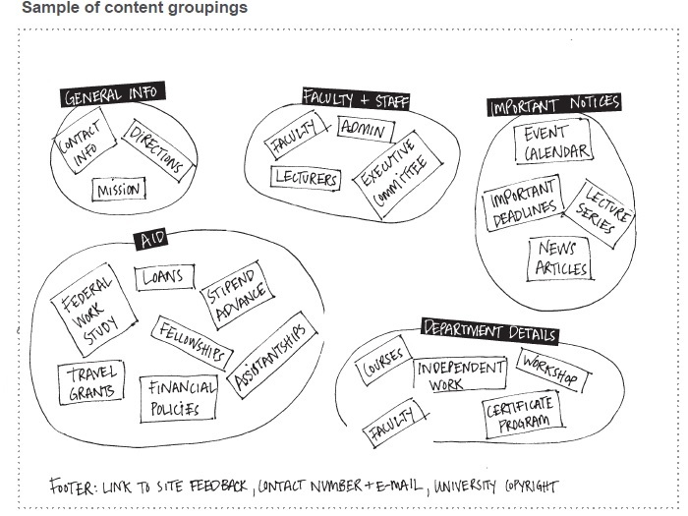
How do we create great information architecture?
Step 5. Organizing the content areas and grouping content
In this step, project team will organize the content areas that they want to find on new AUS website.

Slide 29
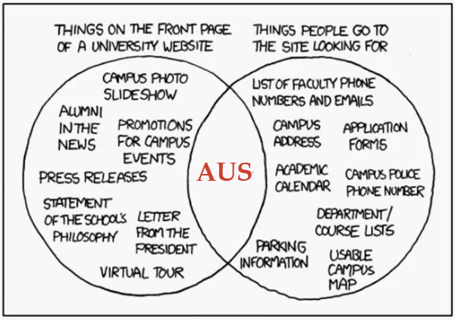
How do we create great information architecture?
Step 6. Creating the site map

Slide 30
Primary Navigation | Secondary Navigation
About AUS AUS at a Glance AUS's Chancellor AUS's Leadership & Boards Academic Tour Administrative Offices Directories AUS in Community News Admissions & Grants Undergraduate Programs Graduate Programs Continuing Education Certificate Programs International students Tuition and Fees How to apply Schools & Colleges Business Art and Design Art and Science Engineering Faculty in AUS On Campus Athletics Wellness Commencement Employment Events Library Green Life Visit AUS Faces@AUS Alumni Community Career services Alumni benefits News and events Contact us | Periodical news Contact AUS Make a gift Audience Pathways Faculty Staff Students Alumni Parents Visitors Media Footer Contact AUS Maps & Directions Jobs Social Media Sitemap Privacy Statement Chancellor Office of the Chancellor Biography News History Blog Contact Media Relations Home Photos and Multimedia Press Releases In the News Policies Contact Visit AUS Visit AUS Tours Calendar FAQ

Slide 31
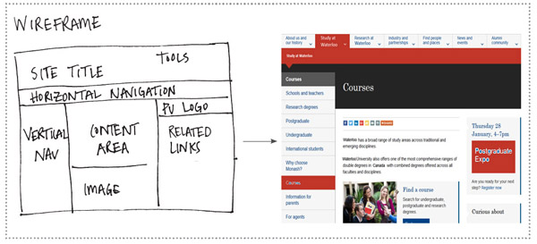
How do we create great information architecture?
Step 7: Creating Wireframes
Emulate the wireframe scheme. A wireframe is a sketch or blueprint that closely represents how the areas of a page will be organized.

Slide 32
AUDIENCES
The web presence must be able to deliver information in an effective and targeted way to meet the needs of each of these groups.

Slide 33
AUDIENCES
Prospective Students
Parents
Prospective Faculty and Staff
Donors
Alumni

Slide 34
AUDIENCES
External Audiences
Potential students (particularly research postgraduates, as well as taught postgraduates and undergraduates), and other opinion formers
Alumni
Business community
Local and regional community
General public
Global research community
Internal Audiences
Current students
Faculty
What’s happening around the University and University procedures (programme regulations, enrolment, graduation…)
Academic support (library, ilearn, Banner…)
Other areas of support (financial, health, accommodation…)
Transactional facilities (payment of bills, printing.)
What’s happening around the University and University procedures (news, events, …)
Accessing online services work-based resources (faculty online profile, email, blackboard/iLearn, library, banner)
Contacts Private or public website?

Slide 35
STRATEGIES FOR CREATING INTERACTION, ENGAGING , OPTIMIZED AUS SITE
Prioritize the pages you optimize
Programs or degrees that have capacity for students and need an enrolment boost.
New programs or degrees that you need to build awareness for.
Programs or degrees that are more unique to AUS and therefore have less competition for search results from competing campuses.
Popular programs and degrees that will have large numbers of students searching for them (e.g. Business, Mas Communications, Civil).

Slide 36
STRATEGIES FOR CREATING INTERACTION, ENGAGING , OPTIMIZED AUS SITE
Incorporate keywords into your web writing
To determine which words and phrases are the most popular (and therefore have the highest search volume), it’s important to conduct keyword research. For maximum effectiveness, insert keywords into headings and subheadings (H1 and H2), body copy, anchor text in links, and photo captions

Slide 37
STRATEGIES FOR CREATING INTERACTION, ENGAGING , OPTIMIZED AUS SITE
Plan your page
Once a visitor has landed on AUS page, the key to getting your copy read is to have clear goals for what AUS would like to accomplish with the page.
Consider how the page relates to other pages
In pre-planning for a page, it’s also helpful to consider how the page relates to other pages on your site.

Slide 38
STRATEGIES FOR CREATING INTERACTION, ENGAGING , OPTIMIZED AUS SITE
Creating effective student engagement
Collaboration and Connecting with Students
Helping Alumni Find Jobs.
Social Media Hub: Social media is a great way of keeping up with all the latest news from the American university of Sharjah.

Slide 39
KEY PRIORTIES
The following priorities until 2020 will aid us in achieving our strategic goals.
The strategy will be ranked depending on which of the priorities they cover.
Online Marketing
Relationship-building and Improving user-experience
The capacity of AUS web presence to build and maintain effective relationships with stakeholders to be improved

Slide 40
KEY PRIORTIES
The following priorities until 2020 will aid us in achieving our strategic goals.
The strategy will be ranked depending on which of the priorities they cover.
Internal communications and service delivery
Internal communications & Structure
Functionality

Slide 41
KEY PRIORTIES
The following priorities until 2020 will aid us in achieving our strategic goals.
The strategy will be ranked depending on which of the priorities they cover.
Create content strategy
Make it easy and efficient
Ensure content is focused
Figure out what content AUS have, what AUS need, and what AUS can eliminate
Identify how AUS new content will be structured and prioritized
Clear workflow

Slide 42
University Web Governance
The university’s web environments will be divided into two websites
Units will determine what web content is public and what content is intended for an internal audience only.
The authoritative source of information for the public site is the Web Steering Committee.
The intranet web pages will follow the same templated and theming.
The internet web pages will designed according each school and college.
All web pages will comply with the university’s brand and visual identity
All standard templates for the home page, inner page, hub pages, and unit-level pages will be developed according to RFP
A private website is a private enviorment network that uses Internet protocols and network connectivity to securely share part of an university's information or operations with its employees.

